Slide 1


STRATEGIES TO IMPROVE CREDIT CARD FRAUD DETECTION
BY- PRASASTI CHOUDHURY
DS C17 BI/DA

Slide 2
AGENDA
BACKGROUND
OBJECTIVE
KEY INSIGHTS
MODEL EVALUATION- COST BENEFIT ANALYSIS
BUSINESS IMPACT
RECOMMENDATION

Slide 3
BACKGROUND
Finex is a leading financial service provider, offering a wide range of products and business services to customers through different channels
Finex has observed that a significantly large number of unauthorised transactions are being made, due to which the bank has been facing a huge revenue and profitability crisis
So branch manager wants to identify the possible root causes and action areas to come up with a long-term solution that would help the bank generate high revenue with minimal losses

Slide 4
OBJECTIVE
Develop a machine learning model to detect fraudulent transactions based on the historical transactional data of customers with a pool of merchants so that Finex is vigilant enough to reduce losses incurred due to such unauthorised transactions by the fraudsters
Analyse the business impact of the fraudulent transactions
Recommend the optimal ways that can be adopted to mitigate the fraud risks

Slide 5
ANALYSIS APPROACH
Basic data cleaning steps like removing of irrelevant columns from dataset and creation of relevant columns like age were performed
Outliers were treated by capping them to the 99th percentile values
One hot encoding was done for the categorical variables
EDA was performed on both categorical and continuous variables and some key insights were drawn.
Standardisation of the numerical variables were done
Imbalance in the dataset was treated with SMOTE technique
Different models were evaluated with recall as the most important metric, and random forest was found out to be the most efficient model to detect fraudulent transactions.
Most important variables impacting the business model was identified.
Cost Benefit analysis was performed to analyse how efficient the model that was built is.

Slide 6
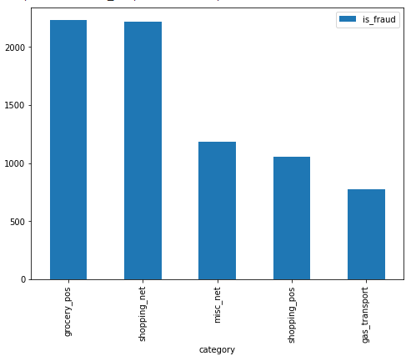
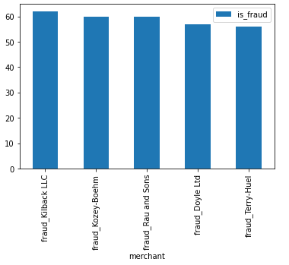
KEY INSIGHTS FROM EDA
Categories with most fraudulent transactions:
Card swiping POS like groceries and shopping and online transactions like shopping and miscellaneous, and gas transport are the five categories with the most fraudulent transactions
So there is a need to be vigilant enough for transactions that belong to the mentioned five categories
Merchants with most fraudulent transactions:
The 5 merchants via which most of the fraudulent transactions take place are: fraud_Kilback LLC, fraud_Kozey-Boehm, fraud_Rau and Sons, fraud_Doyle Ltd and fraud_Terry-Huel
So transactions via these merchants needs to be monitored carefully

Slide 7
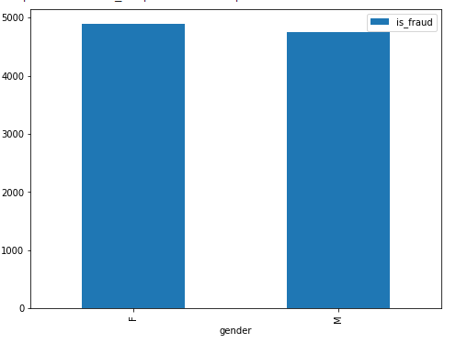
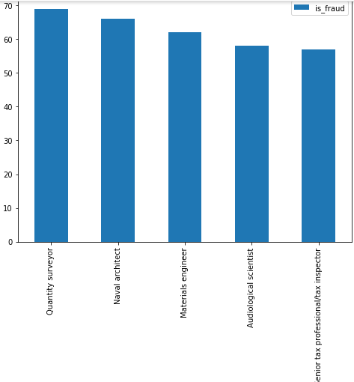
KEY INSIGHTS FROM EDA
Gender of the customers for whom fraudulent transactions have been flagged:
From the plot it can be seen that there is very slight difference between male and female customers whose transactions have been flagged as fraud.
Either the female customers commit fraud more than the male , or the female customers are more targeted by the fraudsters
Jobs with the most fraudulent transactions:
Fraudsters target the people of the profession of Quantity surveyor, Naval architect, Materials engineer, Audiological scientist and Senior tax professional/ inspector the most .
This is because people from these profession are high valued customers and rich. They generally tend to check their bank statements not that often.

Slide 8
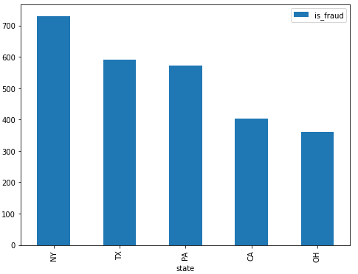
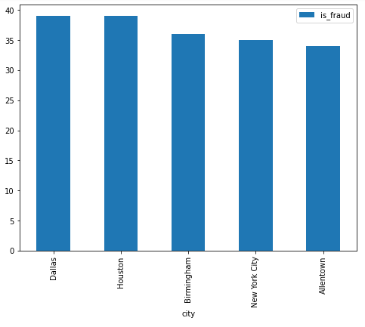
KEY INSIGHTS FROM EDA
States in which most fraudulent transactions takes place:
New York City has the most number of fraudulent transactions followed by Texas, Pennsylvania, California and Ohio respectively
So it can be seen that people of states with highest per capita income are targeted more by fraudsters.
Cities with most fraudulent transactions:
Dallas and Houston in Texas, NY city in NY and AllenTown of Pennsylvania are the cities with the most number of fraudulent transactions.
Here Birmingham which is a city in Alabama, state with not that high per capita income is also there in the list of top cities with the most fraudulent transaction

Slide 9
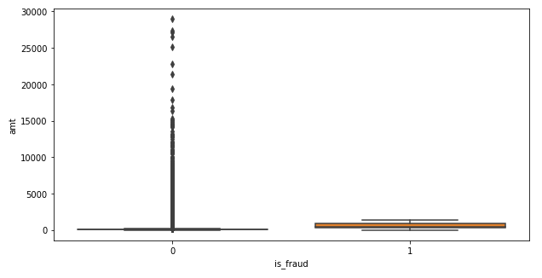
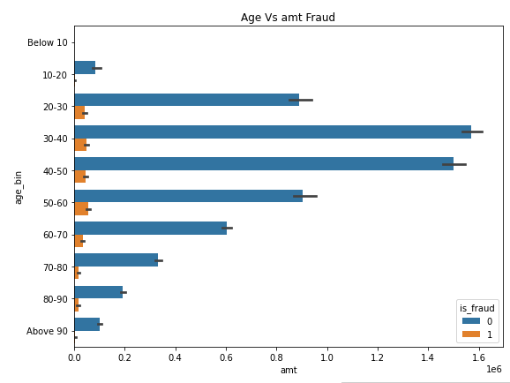
KEY INSIGHTS FROM EDA
Amount Range for Fraudulent transaction:
The plot shows that fraudulent transactions take place mostly in the range where the amount of transaction is less that 2500.
Age group with most fraudulent transactions:
From the above plot it can be seen that the ratio of fraudulent transaction to the total number of transactions is much higher for the age group 50-60.
Since this age group is not that tech savvy, most of the fraudsters targets this group

Slide 10
MODEL BUILDING AND EVALUATION- I
Several models were built with the training and test set and the best model was evaluated.
Random Forest model with the SMOTE imbalancing technique and hyperparameter tuning gave the best model which had a high recall and high AUROC value.
Recall was chosen as the main metric because we do not want a transaction which is fraud to be labelled as a non-fraudulent transaction i.e. we want to reduce the number of false negatives. False positives are still fine in our model as if we label a non fraudulent transaction as a fraudulent transaction despite it being not one, it will not lead to a significant impact on our business.

Slide 11
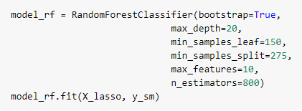
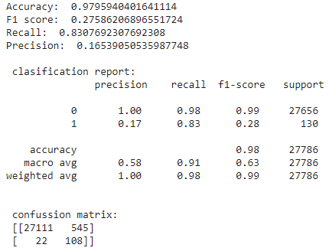
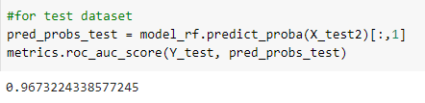
MODEL BUILDING AND EVALUATION- II
Random forest model was built with the best hyperparameters to give the optimised model
This model also gave a recall of 83.07% which is the highest among all the model. And since recall is the most important metric for out business case scenario, this model will help in detecting fraudulent transaction more and lower the chance of letting go a fraudulent transaction as undetected.
It gave an AUROC score of 96.7% the best among all the models built

Slide 12
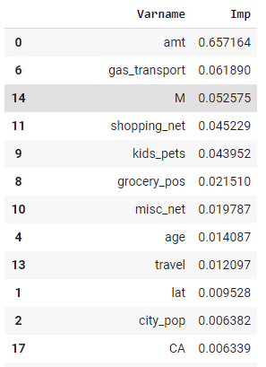
MODEL BUILDING AND EVALUATION- III
The important variables impacting the model was found out which also shows the amount of importance that should be given to each variable.
Amount of transaction, transaction categories like gas_transport, online shopping, grocery shopping, etc , age , gender are some of the high importance variables which must be taken into consideration.

Slide 13
COST BENEFIT ANALYSIS
Cost benefit analysis was also done to calculate how much savings the model which I have built is making which in turn will help Finex with the loss.
Cost incurred per month before the model was deployed was found to be $16211.8
Cost incurred per month after the model is built and deployed was calculated to be $13173
So the total savings that Finex bank will be able to make = $(16211.8 – 13173) = $3038.8
So the model that I have built if used by the Finex bank, it will be able to save a lot by reducing the loss incurred when not being able to detect fraudulent transaction.

Slide 14
BUSINESS IMPACT
Since grocery shopping, online transactions and gas transport are high frequency fraudulent transactions, banks might face significant cash crunch repaying the loses to affected customers.
The merchants which were identified as having the most no. of fraudulent transactions, might have weak online security protocols which needs to be improved
Transactions are found to be not gender-biased
Since the highest number of fraudulent transactions are faced by the high salaried people, it is difficult to keep a check when the transaction amounts are low.
If there are higher number of customers from New York city, Texas, Pennsylvania, California and Ohio, then the loss for the banks will rise.
It is observed that the fraudulent transactions are taking place for low volume amounts
The ratio of fraud transactions to total transactions for the age group of 50-60 is higher than the age group of 30-40 or 40-50, which essentially means older generations are less tech savvy.

Slide 15
RECOMMENDATION
An added level of security like OTP, high security password, etc needs to be added when card swiping takes place in POS like grocery shopping, gas transport,etc
The merchants with the highest number of fraudulent transactions must be given warning to improve their security protocols
Since high salaried people are less keen for monthly check of their transactions, a service could be initiated which would identify fraudulent transactions for them. This can be a revenue generating source.
An added layer of security must be added for transactions that takes place from the city and state with the highest fraudulent transactions.
Transactions carried out using cards listed to older generation mainly in the agegroup of 50-60 , should employ an added level of security(needs to be simple)

Slide 16
THANK YOU

